Slide 1
Workshop Analysis of biomolecules by Mass Spectrometry
Karin Struijs, Ingrid Paffen

Slide 2
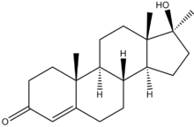
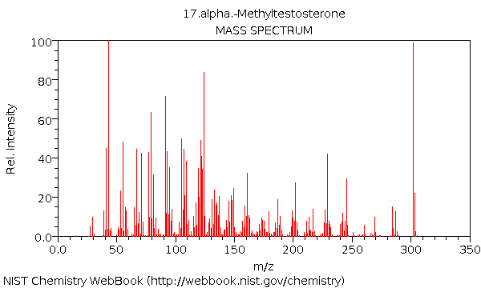
Mass Spectrum (methyl-testosterone)
Mw=302 Da

Slide 3
Outline
Mass Spectrometry
Ionization
Mass separation
Detection
Separation prior to MS
Volatile compounds by GC-MS
Small molecules by LC-MS
Proteins/peptides by (LC)-MS

Slide 4
Mass Spectrometry
What is Mass Spectrometry?
→Technique for studying masses of atoms, molecules or fragments of molecules

Slide 5
Mass spectrometry
3 fundamental parts:
the ionisation source: molecules are charged
the analyser: separation of the charged molecules
the detector
In the ionisation source, ions (charged molecules) are being formed (positive or negative).
Separation in analyser according to mass-to-charge ratios (m/z).
Detection of separated ions and their relative abundance.
Signals sent to data system and formatted in a spectrum.

Slide 6
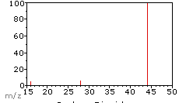
Mass spectrum: intensity vs m/z
Mass-to-charge-ratio = m/z-ratio
m = mass
z = charge
Intensity is mostly indicated as relative abundance
A gas sample has been analyzed by GC-MS. Most likely a [M•]⁺ ion was formed. What could this compound be?
https://www2.chemistry.msu.edu/faculty/reusch/virttxtjml/Spectrpy/MassSpec/masspec1.htm 140924

Slide 7
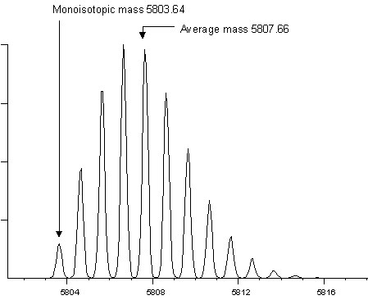
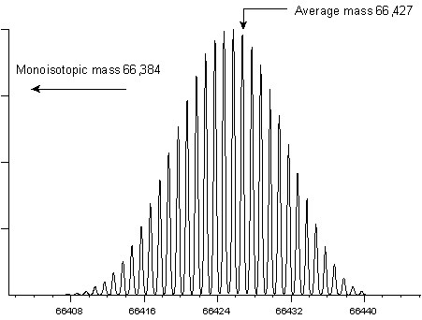
Isotopes: MS Spectra
Left a relatively small protein (insulin). Right a large protein (BSA). http://www.matrixscience.com.

Slide 8
Isotopes
Atomic mass or average mass: weighted average of the masses of the isotopes of an element.
Molecular mass: sum of the atomic masses of the elements present in a molceule
Nominal or monoisotopic mass: Mass of a molecular ion or molecule calculated using the isotope mass of the most abundant constituent element isotope of each element rounded to the nearest integer value and multiplied by the number of atoms of each element (IUPAC).

Slide 9
sample
MS¹
Ionization
ions
Selection/isolation
1 isolated ion
MS²
Fragmentation by adding energy
fragments
Selection/isolation
MS³
1 isolated fragment
Fragmentation by adding energy
fragments

Slide 10
Fragmentation (in-source; MS/MS of MS^{n})
In-source fragmentation occurs due to high energy ionization
MS/MS or MS^{n} are controlled fragmentation processes.
Fragments give information about the structure of a molecule

Slide 11
Ionization
Hard ionization: ionization occurs due to interaction with energetic electrons
atom or molecules accepts or donates an electron
fragmentation occurs
m/z-ratio = 228 [M•]⁺ or M⁺
Soft ionization: ionization occurs due to interactions within the gas phase
Atom or molecule accepts or donates a proton or forms an adduct
Little fragmentation
m/z-ratio = 229 [M+H]⁺ or 227 [M-H]⁻

Slide 12
Ionization techniques
Soft
Electrospray Ionization (ESI)
Atmospheric Pressure Chemical Ionization (APCI)
Atmospheric Pressure Photo Ionization (APPI)
Matrix Assisted Laser Desorption Ionization (MALDI)
Hard
Chemical Ionization (CI)
Electron Impact (EI)
Fast Atom Bombardment (FAB)
Field Desorption / Field Ionization (FD/FI)

Slide 13
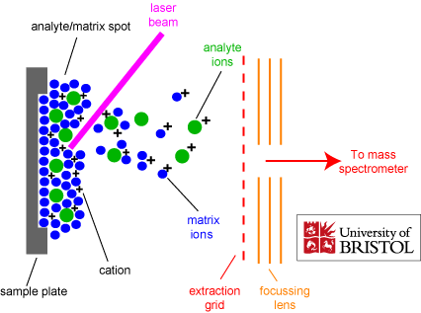
Matrix assisted laser desorption ionozation
www.chm.bris.ac.uk (130918)

Slide 14
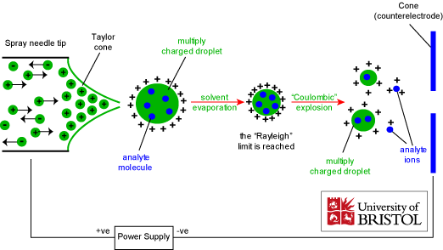
Electrospray ionization
www.chm.bris.ac.uk (130918)

Slide 15
Ionization techniques
Soft
Electrospray Ionization (ESI)
Atmospheric Pressure Chemical Ionization (APCI)
Atmospheric Pressure Photo Ionization (APPI)
Matrix Assisted Laser Desorption Ionization (MALDI)
Hard
Chemical Ionization (CI)
Electron Impact (EI)
Fast Atom Bombardment (FAB)
Field Desorption / Field Ionization (FD/FI)

Slide 16
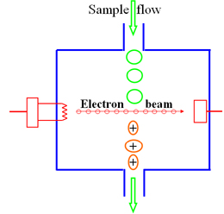
Electron impact
http://departments.agri.huji.ac.il/zabam/myimages/EI%20source-2.JPG 140924

Slide 17
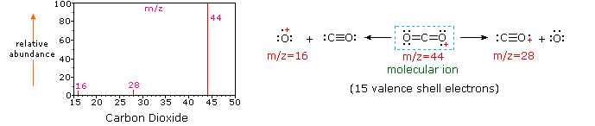
Fragmentation of CO₂
https://www2.chemistry.msu.edu/faculty/reusch/virttxtjml/Spectrpy/MassSpec/masspec1.htm 140924

Slide 18
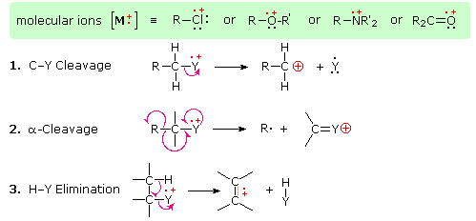
Fragmentation mechanisms
Fragmentation yield new ion + neutral fragment
https://www2.chemistry.msu.edu/faculty/reusch/virttxtjml/Spectrpy/MassSpec/masspec1.htm 140924

Slide 19
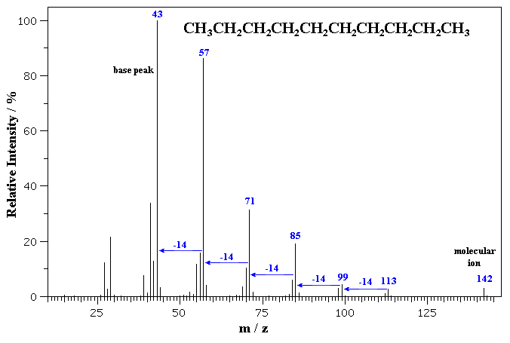
Mass spectrum of …..? (element composition: C + H)
Hard or soft ionization?
www.mhhe.com (130923)

Slide 20
Mass spectrum of decane
Hard ionization
www.mhhe.com (130923)

Slide 21
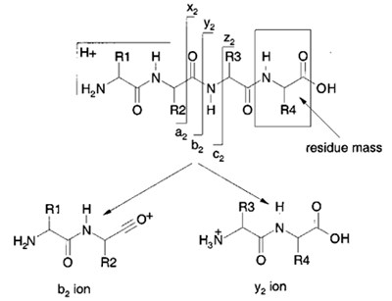
EI ionisation of a peptide (MS-MS)
Aebersold and Goodlett 2001 Mass spectrometry in proteomics. Chemical Reviews 101(2): 269-295.

Slide 22
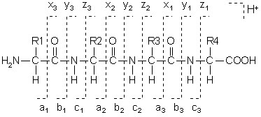
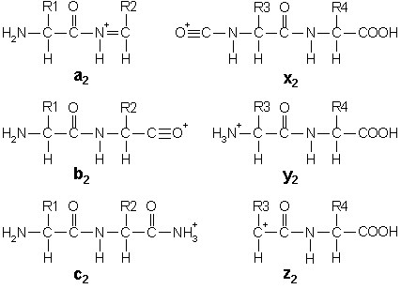
Nomenclature peptide fragmentation. Picture from Matrix Science, http://www.matrixscience.com/help_index.html.

Slide 23
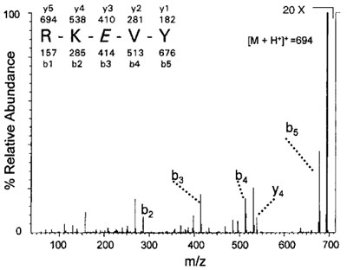
Aebersold and Goodlett 2001 Mass spectrometry in proteomics. Chemical Reviews 101(2): 269-295.

Slide 24
Mass Analyzers
TOF
Quadrupole
Ion-trap
Tri-wave

Slide 25
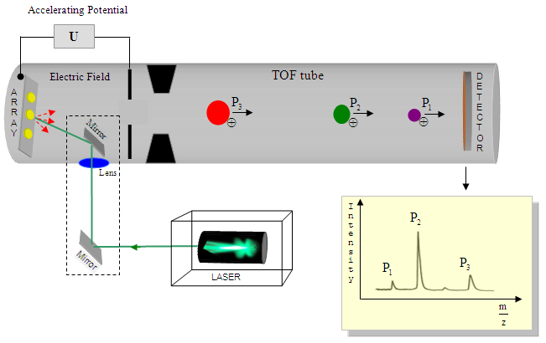
TOF (Time of Flight)
http://www.intechopen.com/source/html/38026/media/image95.png 141001
Molecules travel a certain distance through a tube.
Heavy molecules travel slower than light molecules and bump to a different spot on the detector.

Slide 26
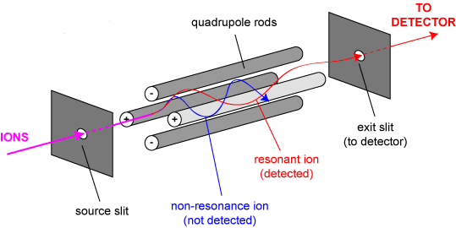
Quadrupole
http://www.bris.ac.uk/nerclsmsf/images/quadrupole.gif
141001
Low cost
Radio Frequency oscillating voltage on the quadrupole rods
Ions are resonating, if not they are discarded
Different mass/charge ratio’s are selected by varying volts

Slide 27
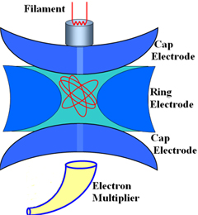
Ion-trap
A constant RF voltage is applied to the central ring electrode.
Charged molecules circulate in orbits, the ions with the lowest m/z outermost orbit
Changing the RF: sending out ions with specific m/z.
http://departments.agri.huji.ac.il/zabam/myimages/iontrap_5.jpg
141001

Slide 28
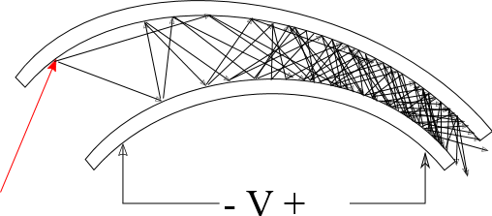
Detector
http://upload.wikimedia.org/wikipedia/commons/6/67/Electron_multiplier.svg 140922

Slide 29
Why separation before MS?

Slide 30
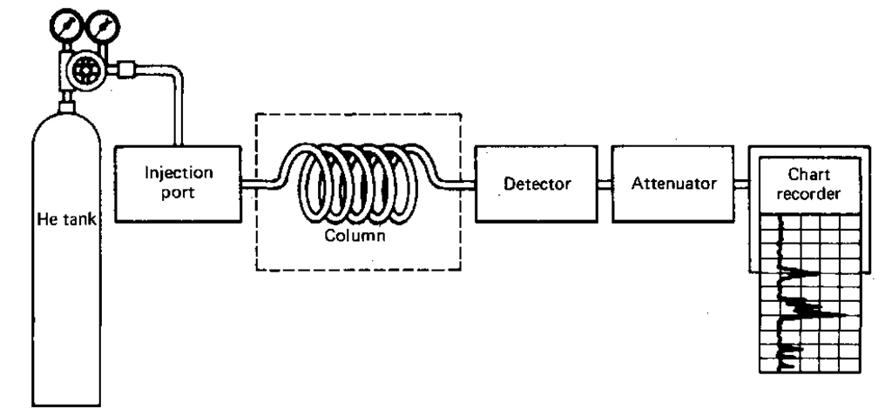
GLC: Gas Liquid Chromatography
source: http://what-when-how.com/wp-content/uploads/2011/06/tmp17040_thumb1.png

Slide 31
GLC
Used to separate volatile compounds
Non-volatile compounds need to be made volatile
temperature
derivatization

Slide 32
GLC
Stationary phase: long hollow inert fibre, coated with a thin layer of sorbent
Mobile phase: gas (helium, nitrogen, air)
Sample is injected as liquid, but is immediately evaporated by heat.
The volatile compounds are carried though the column by the mobile phase (gas)
separation occurs due to:
temperature profile
interaction with the stationary phase
Sample components are identified based on their retention time. ←→ compare with known compounds

Slide 33
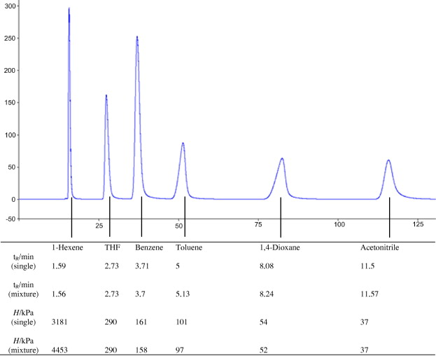
Interpretation of GC data
GC chromatogram of solubility of various organic compounds in 1-ethyl-3-methylimidazolium acetate
From: Rosenboom et al., 2012, The Journal of Chemical Thermodynamics, 47, 320-327

Slide 34
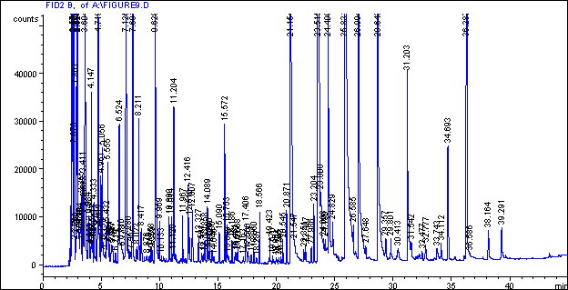
Interpretation of the data
GC Chormatogram: ODOR CARRYING CHARACTERISTICS OF DUST FROM SWINE FACILITIES
Wang et al., 1998, ASAE Annual International meeting, Orlando, FL

Slide 35
Advantages and disadvantages
Sensitive technique
Method of choice for volatile compounds
Process of isolation, hydrolyzation, derivatization and analyses by GC = time consuming
Derivatisation process can produce artefacts and PUFA’s (poly unsaturated FA) may modify structure

Slide 36
HPLC
High performance or pressure liquid chromatography
Commonly used in analysis of biological compounds
Applications:
Pharmaceuticals: antihistamin, steroids
Food: vitamins, lipids, protein
Contaminants: pesticides
Environment: polycyclic aromatic hydrocarbons (PAH)

Slide 37
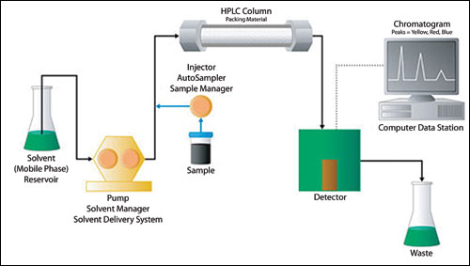
HPLC
http://www.pharmacelsus.de/uploads/pics/hplc.jpg 141001

Slide 38
HPLC Columns
Contains spherical, micro porous particles of silica or polymer called stationary phase
Stationary phase is inert, stable until pH 8 and can be modified for different types of chromatography
Types of stationary phase:
Reversed phase (C8, C18)
Normal phase (Silica)
Ion exchange
Size exclusion (also called GPC)
Affinity

Slide 39
Mobile phases
Water
Organic solvent; acetonitrile, methanol, hexane and many more
Buffer for pH regulation; mineral (phosphate) or organic (acetate)
These solvents are used for the mobile phase or eluent.
The solvents are very pure and no air and solids should be present in the mobile phase.
Composition depends on compound, stationary phase and detection.
When in combination with MS:
solvents + modifiers must be volatile

